Slide 1
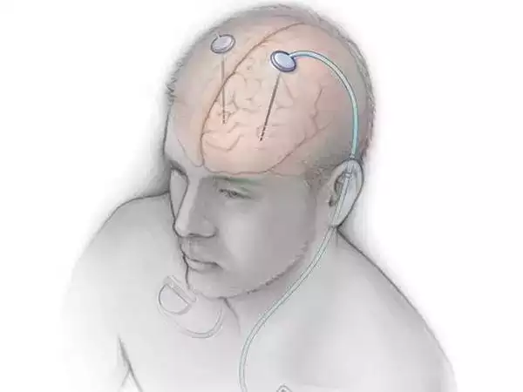
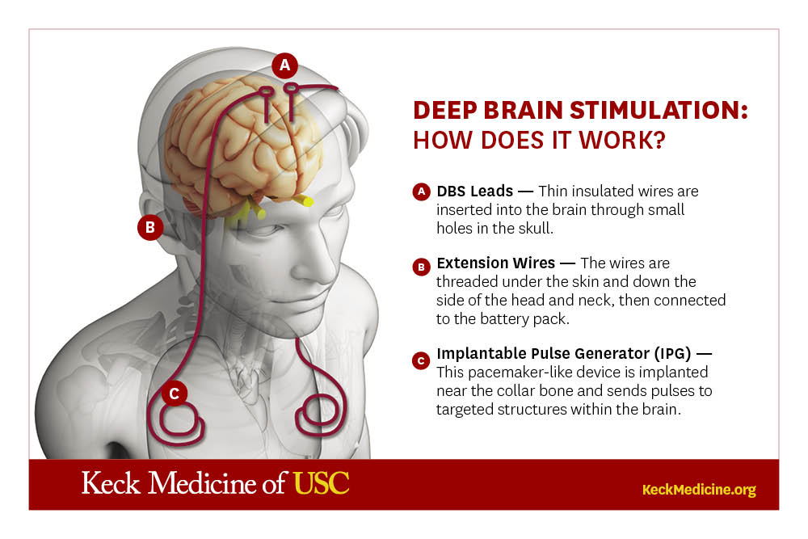
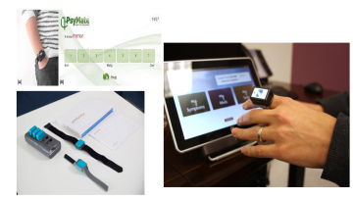

Slide 2
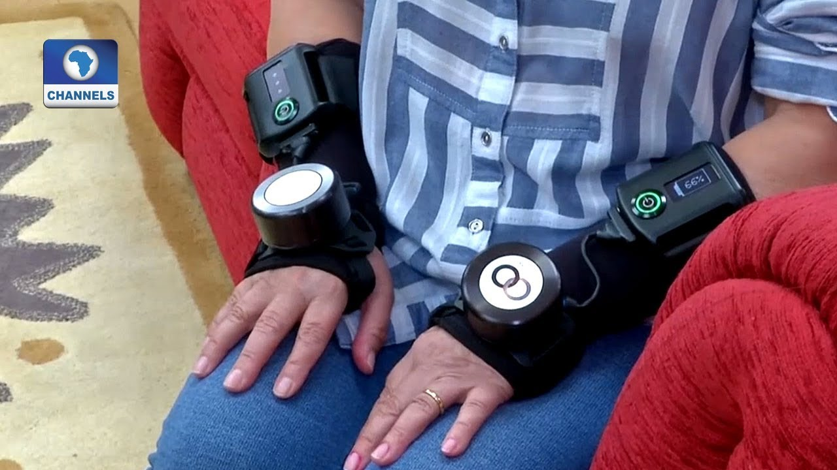
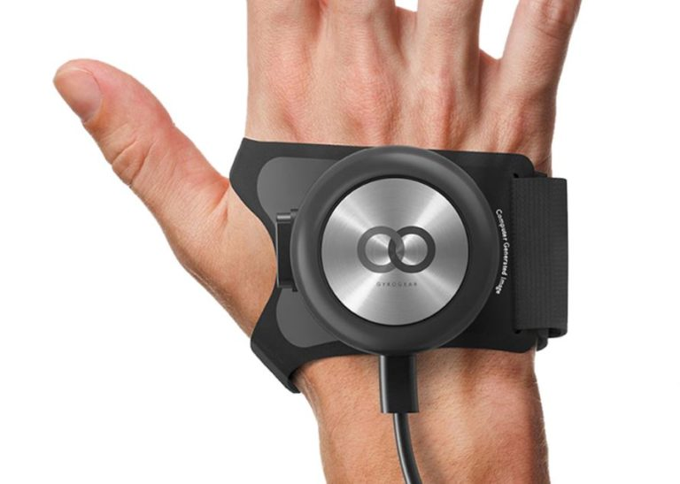

Slide 3
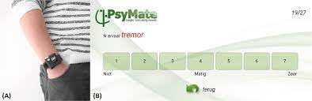

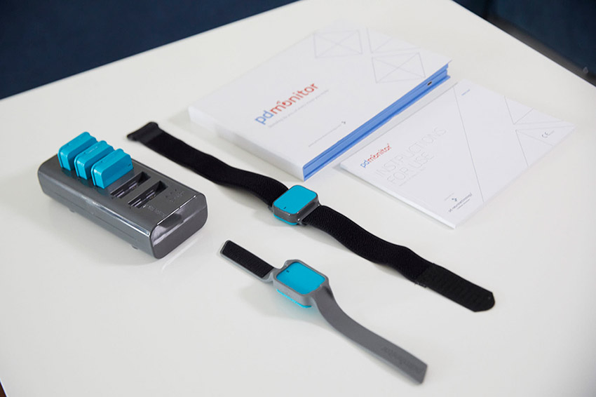

Slide 4

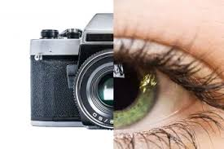
Biology for Engineers
21BE45 Eye as a camera system
Ms. Supreetha K
Assistant Professor
Department of Biotechnology
Dayananda Sagar College of Engineering
Bangalore
supreetha-bt@dayanandasagar.edu
9916315305

Slide 5
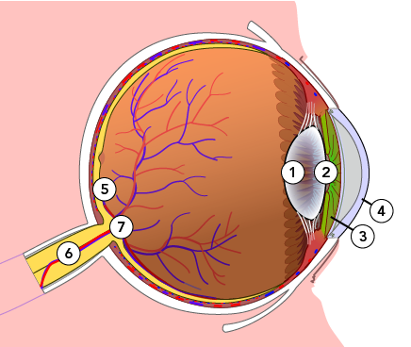
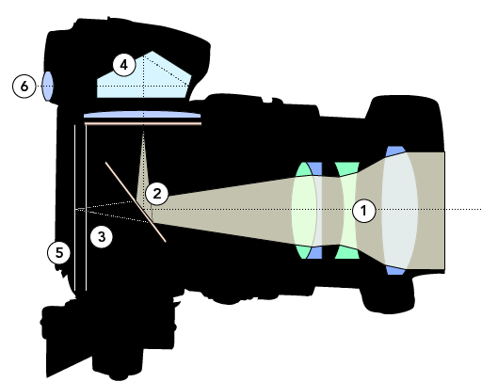
Biology for Engineers
Human organ systems and bio designs
Eye as a Camera system
There are many similarities between the human eye and a camera, including a diaphragm to control the amount of light that gets through to the lens. This is the shutter in a camera, and the pupil, at the centre of the iris, in the human eye.
In a camera, the film is used to record the image; in the eye, the image is focused on the retina, and a system of rods and cones is the front end of an image-processing system that converts the image to electrical impulses and sends the information along the optic nerve to the brain.

Slide 6
Biology for Engineers
Human organ systems and bio designs
Eye as a Camera system
Retinas, film, and imaging sensor chips all have one other thing in common. They all receive an inverted (upside-down) version of the image.
The lens in both an eye and a camera is convex, or curved outwards. When light hits a convex object, it refracts. This flips the image upside-down.
But upside –down images are not visible to the eye because the brain steps in to and corrected it help your eyes as It knows the world is supposed to be right side up. So it flips the image over again.
Digital cameras are programmed to make the correction on their own.
Non-digital cameras contain a prism or mirror that flips the image so it appears right side up. Film is transparent so you can view the images on it the right way around.

Slide 7
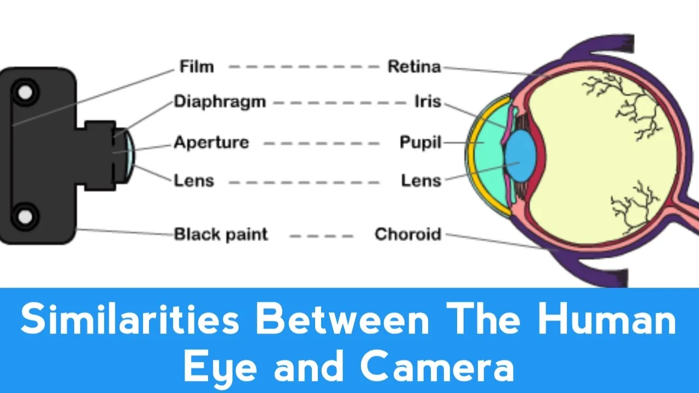

Slide 8
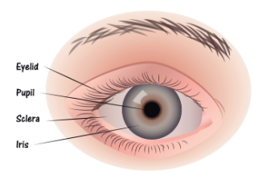
Biology for Engineers
Human organ systems and bio designs
Eye as a Camera system
OUR EYES WORK LIKE CAMERA’S!
The inner workings of the human eye are complex, but at the same time, fascinating. How exactly they do work or what are the major parts of the eyeball involved in creating vision?
These tiny cameras spend every day processing millions of pieces of information at lightning fast speeds, and turn them into the simple images we see almost instantly.
The eye has several distinct parts, each of which has specific responsibilities that work together like a machine.

Slide 9
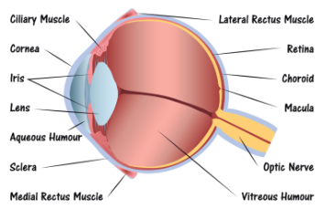
Biology for Engineers
Human organ systems and bio designs
Eye as a Camera system
There are specific parts of the eye that make this focusing process possible. Each beam of light that hits the eye goes through a series of steps:
Step 1: Light passes through a thin layer of moisture
Step 2: Light hits the cornea. The cornea is transparent, and is the first layer to begin focusing light within the eye. The cornea is connected to the sclera, which is a tough fiber on the outside of the eye that acts as protection.
Step 3: Behind the cornea is another liquid layer known as the aqueous humor, and its job is to maintain pressure levels in the front of the eye as light is passing through.
Step 4: Once light is passes' through the aqueous humor, it is finally reaches the pupil. The pupil is the round entryway of the colored iris.

Slide 10
Biology for Engineers
Human organ systems and bio designs
Eye as a Camera system
Step 5: Once the pupil determines how much light it will let inside your eye, the job passes to the lens. The lens factors in the amount of light the pupil lets in, and figures out how far away you are from the object that the light is reflecting off of, or the object you’re trying to see. From there, the lens focuses the image into an accurate view of what you’re looking at.
Part of this process is controlled by muscles in the lens called ciliary muscles, which expand and contract to pull on the lens and allow it to focus properly.
Step 6: As light reaches the center of the eye passes through another layer of moisture, called the vitreous, or vitreous humor. Then, it reaches the final stop in the process: The Retina.

Slide 11
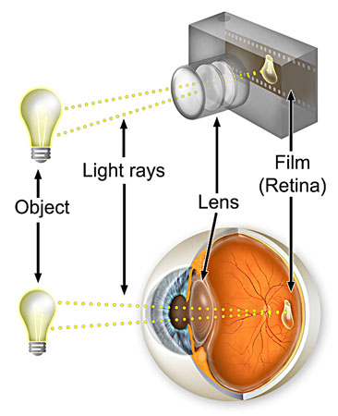
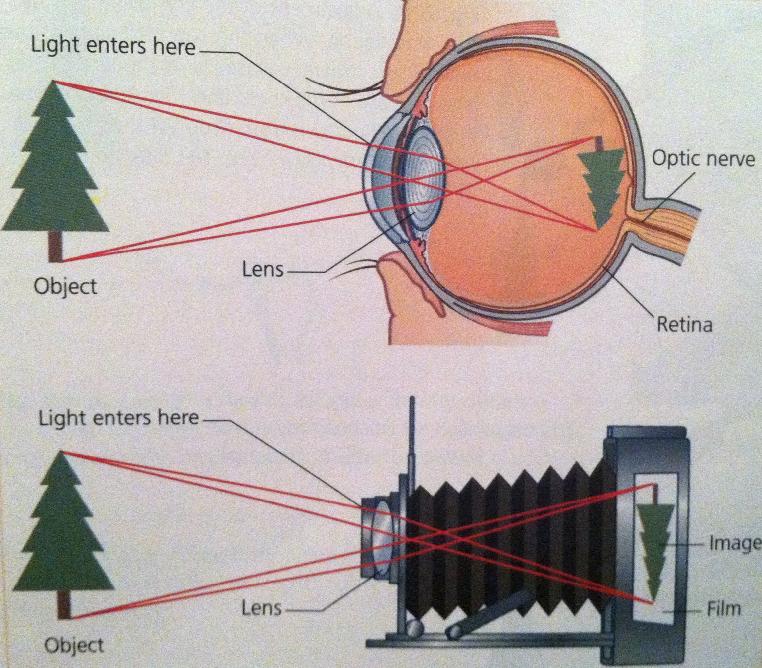

Slide 12
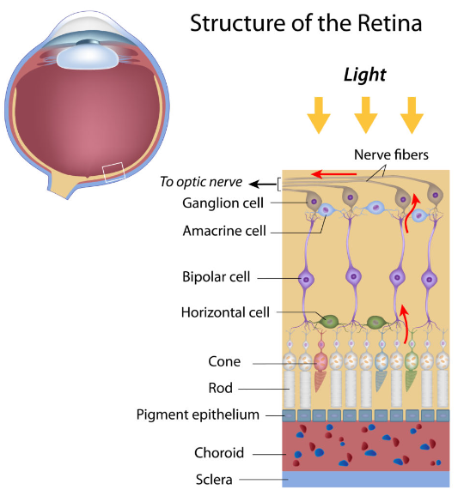
Biology for Engineers
Human organ systems and bio designs
Eye as a Camera system
The retina is the back of the eye. If the lens in your eye is most like a camera, the retina is most like its film – this is where the final product is projected. The retina has several parts:
Macula: The center of the retina. The center point of the macula is called the fovea, and it has the most photoreceptors and nerve endings of any part of the eye.
Photoreceptors: Split into two designations – rods and cones.
Cones are in the macula. When there is bright light, cones provide clear, sharp central vision and detect colors and fine details.
Rods are located outside the macula and extend all the way to the outer edge of the retina. They provide peripheral or side vision. Rods also allow the eyes to detect motion and help us see in dim light and at night.

Slide 13
Biology for Engineers
Human organ systems and bio designs
Eye as a Camera system
Retinal pigment epithelium: Abbreviated RPE, this is a tissue layer below the rods and cones which absorbs any extra, unneeded light.
Choroid: The choroid is behind the retina, and is in charge of making sure the retina and RPE have enough nutrition flowing from small blood vessels.
Once the photoreceptors have converted light into an electronic signal, they send a signal to the brain’s visual command center and you have vision. It’s amazing what even small parts of our bodies can do.

Slide 14
Biology for Engineers
Human organ systems and bio designs
Eye as a Camera system
Architecture of rod cells
Rods are cylindrical shaped photoreceptors. Photoreceptors are image forming cells.
They are more numerous than cone cells, with an estimated 92 million rod cells located in the human retina. They function best in low intensity light (scotopic) and are thus responsible for vision in dimly lit surroundings, such as at dusk.
Rod outer segments are cylindrical in shape, consisting of around 1000 flat, lobulated, membranous discs.
The inner segment of the rod cell is divided into an outer mitochondria-rich part and an inner part containing endoplasmic reticulum. The structure of the rod cell is consistent across all areas of the retina.
Rod cells are located across the retina except at the centre of the fovea.
The density of rod cells increases as you move away from the fovea, reaching a peak and declining again towards the periphery.
Rod vision provides high sensitivity to light, but with relatively low spatial discrimination and no ability to distinguish different wavelengths of light. This is why they are not capable of detecting different colours.
Compared to cone cells, rods have poor visual acuity, or ability to distinguish fine detail.

Slide 15
Biology for Engineers
Human organ systems and bio designs
Eye as a Camera system
Rod cell summary
Shape | Cylindrical
Number | High
Light sensitivity | High
Visual acuity | Low
Vision type | Night vision
Present at fovea | No
Cell types | Single type
Photopigment types | Achromatic (one type)

Slide 16
Biology for Engineers
Human organ systems and bio designs
Eye as a Camera system
Architecture of cone cells
Cones are conical shaped cells that operate best in high intensity lighting (photopic) and are responsible for the perception of colour.
There are far fewer cone cells in the human retina compared to rod cells, numbering approximately 4.6 million.
Cone outer segments are generally shorter than that of rods and, as their name implies, are often conical. As is the case of rod cells, the inner segment of the cone cells have an outer mitochondria-rich part and an inner part containing endoplasmic reticulum.
There are 3 different types of cone cells: L type, S type, and M type.
Cones are located throughout the entire retina, but are localised around the fovea.
Cone density is higher in the nasal retina compared to the temporal retina, and slightly higher inferiorly than superiorly.
The three different opsins located in the cone cells account for their ability to detect different wavelengths of light, producing colour vision. These three opsins are sometimes classified as red (L-cone), blue (S-cone), and green (M-cone).
The dense packing of cones at the fovea allows maximal resolution.

Slide 17
Biology for Engineers
Human organ systems and bio designs
Eye as a Camera system
Cone cell summary
Shape | Conical
Number | Low
Light sensitivity | Low
Visual acuity | High
Vision type | Color vision
Present at fovea | Yes
Cell types | 3 types: L, S, M
Photopigment types | Chromatic: Red, green, blue

Slide 18
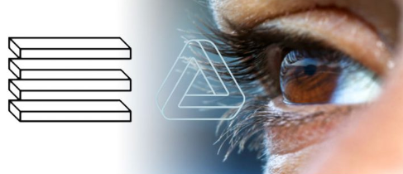
Biology for Engineers
Human organ systems and bio designs
Eye as a Camera system
Optical Corrections
Optical Correction is a slight modification of geometrically correct lines (as of a building) for the purpose of making them appear correct to the eye

Slide 19
Biology for Engineers
Human organ systems and bio designs
Eye as a Camera system
Optical Corrections
When your vision is blurry or fuzzy, it can make it difficult to go about your daily activities.
Many times, blurry or unclear vision is caused by what’s known as a refractive error.
A refractive error occurs when light doesn’t bend correctly as it enters your eye. If the light that enters your eye doesn’t hit your retina correctly — the light-sensitive tissue at the back of your eye — your vision won’t be sharp.
There are four types of refractive errors:
Nearsightedness: Also known as myopia. This condition is the result of an abnormal eye shape that causes light to come into focus before it hits the retina at the back of the eye. This makes it difficult to see objects that are far away.
Farsightedness: Also known as hyperopia. This condition is the result of an abnormal eye shape that causes light to come into focus behind the retina. This makes it hard to see objects close to you.

Slide 20
Biology for Engineers
Human organ systems and bio designs
Eye as a Camera system
Optical Corrections
Presbyopia: It is farsightedness that happens as you age, when your eyes lose the ability to shift focus back and forth between distant and close objects. It’s common for people to start experiencing this kind of farsightedness in their 40s.
Astigmatism: Often causes images to appear distorted and might cause additional symptoms such as double vision or slanted vision. It generally happens when the cornea of your eye is somewhat elongated instead of round, but there can be other causes.
No matter what type of refractive error you have, vision correction can help you see clearly.
Finding the right vision correction option allows you to drive, read, work on a computer, and do other daily tasks without squinting or straining your eyes to see properly.
For many people with refractive errors, these tasks would be impossible without some type of vision correction.

Slide 21
Biology for Engineers
Human organ systems and bio designs
Eye as a Camera system
Optical Corrections
The most common methods of vision correction are wearing eyeglasses or contact lenses.
They help achieve clear vision by refocusing light rays on the retina, compensating for the shape of the eye.
Refractive surgery is another vision correction option. During refractive surgery, such as LASIK, the eye's focusing ability is adjusted by reshaping the cornea (the front surface of the eye).
Each vision correction option has its advantages and drawbacks. Your health, lifestyle, and personal preference are also considerations when deciding on the best vision correction for you.
Types of glasses
There are two primary types of glasses:
Single vision lenses. Single vision lenses have one prescription on the entire lens. They correct either your near vision or your distance vision.
Multifocal lenses. Multifocal lenses correct both near and distance vision in the same lens. Another type of multifocal lenses called trifocal lenses can correct near, middle, and distance vision all in one lens.

Slide 22
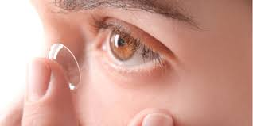
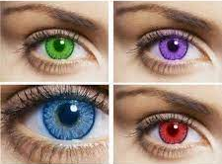
Biology for Engineers
Human organ systems and bio designs
Eye as a Camera system
Contact lenses
Contact lenses are thin clear discs you wear directly on your eye.
The principle is the same as glasses. The thin disc corrects the way light enters your eye. This helps you to see more clearly. Your contact lens prescription is the disc strength that will correct your vision.
During a contact lens exam, you’ll get a prescription for the strength of contact lenses you need. Your prescription might not be the same for both eyes. The prescription for each eye can be different. Your eye doctor will also make sure your eyes are healthy enough for contact lenses.
If you already have a prescription for glasses, it’s important to understand that a prescription for contact lenses won’t the same as the prescription for your glasses.

Slide 23
Biology for Engineers
Human organ systems and bio designs
Eye as a Camera system
Types of contact lenses
There are several types of contact lenses:
Soft contact lenses are the most common type of contact lens today. They’re comfortable and easier to manage than most other types of contacts. They’re typically disposable, and you can choose from contact lenses that you change daily, weekly, biweekly, or monthly.
Hard contact lenses are firm and made of a thin plastic that lets oxygen pass into your eye easily. They’re often a good option for people with astigmatism.
Multifocal contact lenses can correct both near and distance vision at the same time.
Hybrid contact lenses. Hybrid contacts combine hard and soft contacts together. The center is rigid but the outside is soft, allowing for a more comfortable fit.
Toric contact lenses are specialized soft contact lenses designed for people with astigmatism.
Cosmetic contact lenses change the color or appearance of your eyes without correcting your vision. You still need a prescription for these lenses, and they need to be cleaned and cared for just like regular contacts.

Slide 24
Biology for Engineers
Human organ systems and bio designs
Eye as a Camera system
Vision correction surgery
Vision correction surgery can correct the way your eye processes light which, in turn, helps you to see more clearly.
Some types of surgery can even involve a lens that’s implanted into your eye to correct your vision.
Vision correction surgery is a popular option for people who don’t want to wear glasses or contact lenses. One of the best-known types of vision correction surgery is LASIK.
But there are several other types of vision correction surgery.
LASIK. LASIK surgery is done by creating a small flap in your cornea, and then using a laser to change the shape of the cornea. This changes the way light reaches the retina. It can be used for nearsightedness, farsightedness, or astigmatism.
Wavefront-guided LASIK. This procedure involves measuring your eye from front to back with a special type of laser technique known as “wavefront” technology. This creates a 3-D image of your eye and allows for a more customized surgery based on your eye measurements.
Photorefractive keratectomy (PRK). PRK is the most common alternative to LASIK. It involves removing the epithelial layer of the cornea and then reshaping it with a laser.

Slide 25
Biology for Engineers
Human organ systems and bio designs
Eye as a Camera system
EpiLasik. EpiLasik follows many of the same steps as PRK. The difference is that the epithelial layer of your cornea is saved and put back in place after your cornea is reshaped.
SMILE. An acronym for small incision lenticule extraction, this surgery is similar to LASIK, but the surgeon makes a smaller incision to alter the shape of the cornea in order to correct nearsightedness.
Conductive keratoplasty (CK). This procedure uses heat to shrink and tighten the cornea. It’s used for people over 40 with mild to moderate farsightedness.
Phakic intraocular lenses (IOLs). Phakic IOLs are surgically implanted lenses placed in front of the natural lens of the eye. This procedure is often used for people who need strong vision correction that can’t be corrected with standard LASIK or PRK.
Refractive Lens Exchange (RLE). RLE replaces the natural lens of the eye with an artificial lens. It can be used for people who are farsighted whose vision can’t be corrected with LASIK or PRK.

Slide 26
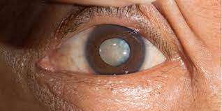
Biology for Engineers
Human organ systems and bio designs
Eye as a Camera system
Cataract
A cataract is a cloudy area in the lens of your eye (the clear part of the eye that helps to focus light). Cataracts are very common as you get older.
At first, you may not notice that you have a cataract. But over time, cataracts can make your vision blurry, hazy, or less colorful.
You may have trouble reading or doing other everyday activities.
Over time, cataracts can lead to vision loss.
Surgery can get rid of cataracts. Cataract surgery is safe and corrects vision problems caused by cataracts.
Symptoms of cataracts
Cloudy or blurry
Colors look faded
You can’t see well at night
Lamps, sunlight, or headlights seem too bright
You see a halo around lights
You see double (this sometimes goes away as the cataract gets bigger)

Slide 27
Biology for Engineers
Human organ systems and bio designs
Eye as a Camera system
Treatment for cataracts
Surgery is the only way to get rid of a cataract, but you may not need to get surgery right away.
Home treatment: Early on, you may be able to make small changes to manage cataracts. You can do things like:
Use brighter lights at home or work
Wear anti-glare sunglasses
Use magnifying lenses for reading and other activities
New glasses or contacts: A new prescription for eyeglasses or contact lenses can help you see better with cataracts early on.
Surgery: Your doctor might suggest surgery if your cataracts start getting in the way of everyday activities like reading, driving, or watching TV. During cataract surgery, the doctor removes the clouded lens and replaces it with a new, artificial lens (also called an intraocular lens, or IOL). This surgery is very safe, and 9 out of 10 people who get it can see better afterwards.

Slide 28
Biology for Engineers
Human organ systems and bio designs
Eye as a Camera system
Lens Materials
Common Eyeglass Lens Materials
Standard glass
Glass had been the material most widely used for ocular lenses until the 1970s. Glass provides superior optical quality and has the most scratch-resistance surface, however it has several limitations including heavy weight, increased thickness, and low impact resistance.
Chemical or thermal tempering can increase the shatter resistance.
Standard plastic
Plastic lenses gained popularity in the 1970s and have the benefits of weighing half as much as glass lenses due to their lower specific gravity and having high optical quality.
CR-39 which stands for Columbia resin #39 is the most commonly used plastic polymer lens material.
The lenses block 80% of ultraviolet light without treatment, and can be tinted and coated to provide further ultraviolet light blocking.
Plastic lenses tend to have a lower index of refraction, which require thicker lenses.

Slide 29
Biology for Engineers
Human organ systems and bio designs
Eye as a Camera system
Polycarbonate
High index polycarbonate lenses were popularized in the 1980s due to light weight, thin profile, superior impact resistance, and ultraviolet protection.
These lenses are often recommended for children, young adults, individuals with active lifestyles, and as safety eyewear.
They are very durable and can be up to 30% thinner than regular glass or plastic lenses.
Trivex
Trivex was introduced in 2001 and is a highly impact-resistant material with a low specific gravity delivering strong optical quality.
Trivex is also able to block nearly all ultraviolet light. A disadvantage of Trivex lenses is its low index of refraction, thus requiring thicker lenses for higher powers.
A scratch-resistant coating is required for this lens.

Slide 30
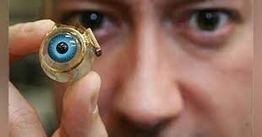
Biology for Engineers
Human organ systems and bio designs
Eye as a Camera system
Bionic Eye
Bionic eye, electrical prosthesis surgically implanted into a human eye in order to allow for the transduction of light (the change of light from the environment into impulses the brain can process) in people who have sustained severe damage to the retina.
The bionic eye comprises an external camera and transmitter and an internal microchip.
The camera is mounted on a pair of eyeglasses, where it serves to organize the visual stimuli of the environment before emitting high-frequency radio waves.

Slide 31
The stimulator microchip consists of an electrode array that is surgically implanted into the retina.
That functions as an electrical relay in place of degenerated retinal cells.
The radio waves that are emitted by the external camera and transmitter are received by the stimulator, which then fires electrical impulses.
The impulses are relayed by the few remaining retinal cells and are transduced as normal to the optic nerve pathway, resulting in vision.

Slide 32
Biology for Engineers
Human organ systems and bio designs
Eye as a Camera system
Bionic Eye
The first implantation of a rudimentary version of the bionic eye was reported in 2012. The patient, who suffered from profound vision loss as a result of retinitis pigmentosa, reported being able to see light but not being able to make distinctions within the environment.
The first model was created by the Australian company Bionic Vision Australia.
More-advanced technologies developed since then have been used in newer models implanted into patients whose vision was affected by retinitis pigmentosa.

Slide 33
The improved models have allowed patients glimpses of their environments, enabling them to make out abstract images, though their vision has not been fully regained.
Further research could raise the level of acuity that the bionic eye provides, and different materials, such as diamond, are being tested for their effectiveness in the implant.
Long-term effects of the implantation of a bionic eye remain unknown.

Slide 34
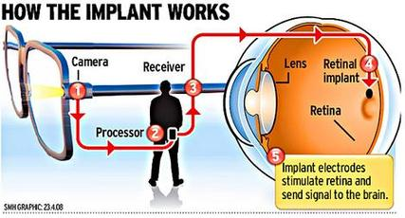

Slide 35


